Slide 1
HDSI Agri Datathon Deliverable (Prompt 2)
Chris Li, Josh Zhang, Joshua Zhang

Slide 2
Introduction:
The average age of farmers has increased to 58.1 years between years 1997 and 2022.
As environmental changes continue to threaten the nation’s food security, farmers represent a key driver in providing ample food resources to all US citizens.

Slide 3
Data and Methodology
Data Cleaning:
Demographic Data: Isolated average year and accounted for NASS naming methodology.
Sales Data: Shrunk columns based on custom-made benchmarks for agricultural productivity.
Adjusting for inflation:
Inflation Index Data: Used 2022 inflation indexes to adjust monetary values to real dollars.

Slide 4
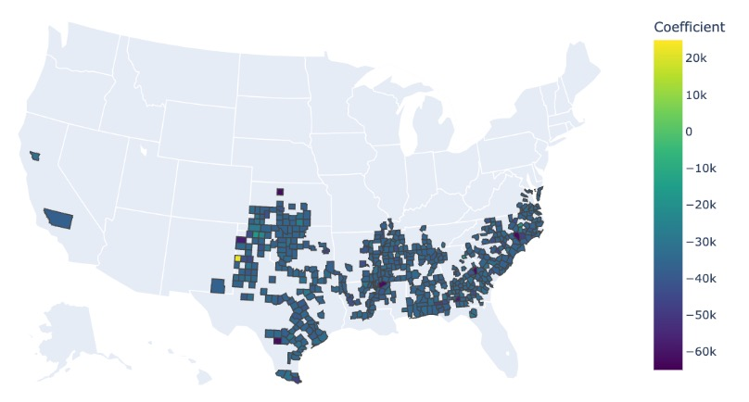
Results
Our results show a negative correlation between agricultural productivity and average farmer age.
The average coefficients of this relationship are especially large in counties located in the southern portion of the United States.

Slide 5
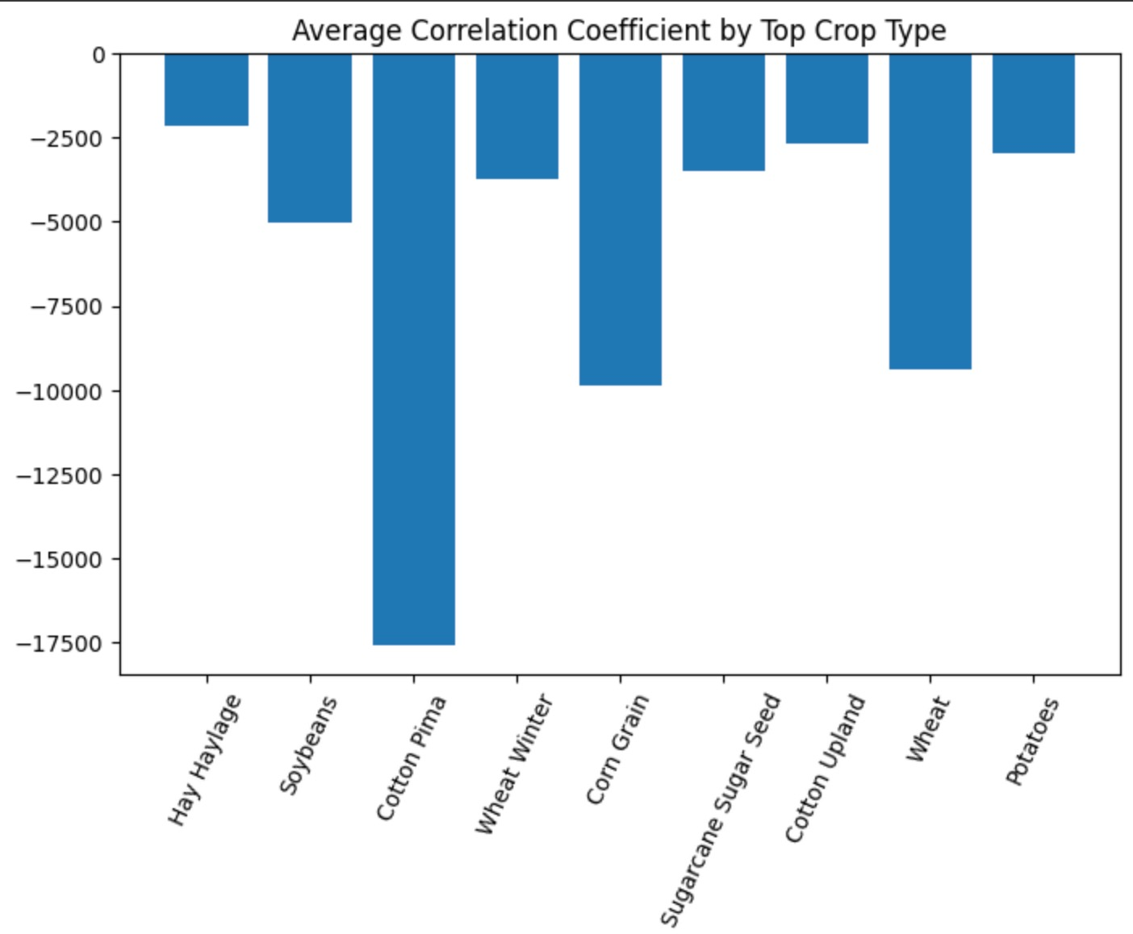
Results (continued)
The negative relationship between average farmer age and agricultural productivity is statistically significant for a select few crops.

Slide 6
Conclusion
Summary:
The aging farmer population shows a negative impact on agricultural productivity.
The correlation between farmer age and productivity is especially prominent in select southern states among a select few crop types.
Potential areas of study:
Investigating the root cause behind the types of crops and why they may drive decreases in productivity compared to other crop types.
More closely examine counties and states with smaller agricultural infrastructure and its impact on productivity as a result of aging farmer populations.

Slide 7
Thank you!

